Slide 1
This slide is hidden.
Insert the starting slides after this slide

Slide 2
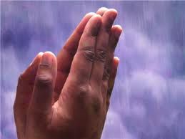
Welcome to St Michael's
8th Sunday of Ordinary Time
Year A
You have entered a
SACRED SPACE
– a SACRED TIME...
Please ensure all mobile phones
are switched off.
Please be respectfully quiet
as we prepare for our celebration.
Notes:
Saturday 5.30PM First Sunday of Advent
MASTER 14th Sunday in Ord Time
MASTER 14th Sunday in Ord Time

Slide 3

Jesus said to his disciples:. You cannot be the slave both of God and of money.

Slide 4
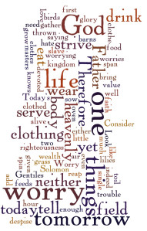
“..I am telling …do not worry…

Slide 5
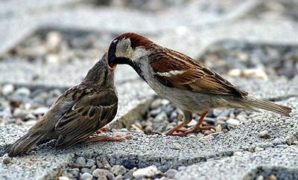
Look at the birds in the sky. They do not sow or reap or gather into barns; yet your heavenly Father feeds them.

Slide 6
What are your worries? – during the coming week – place them in the hands of our God.

Slide 7
Please Stand

Slide 8
This slide is hidden.
Insert the Entrance Hymn after this slide

Slide 9
All the ends of the earth
All the ends of the earth,
All you creatures of the sea,
Lift up your eyes
To the wonders of the Lord.

Slide 10
For the Lord of the earth,
The Master of the sea,
Has come with justice for the world.

Slide 11
Break into song at the deeds of the Lord,
The wonders God has done in ev'ry age

Slide 12
All the ends of the earth,
All you creatures of the sea,
Lift up your eyes
To the wonders of the Lord.

Slide 13
For the Lord of the earth,
The Master of the sea,
Has come with justice for the world.

Slide 14
Heaven and earth shall rejoice in your might;
Ev'ry heart, ev'ry nation call you Lord.

Slide 15
All the ends of the earth,
All you creatures of the sea,
Lift up your eyes
To the wonders of the Lord.

Slide 16
For the Lord of the earth,
The Master of the sea,
Has come with justice for the world.

Slide 18
Confiteor
I confess to almighty God
And to you, my brothers and sisters,
That I have greatly sinned
In my thoughts and in my words

Slide 19
In what I have done
And in what I have failed to do,
Through my fault,
Through my fault,
Through my most grievous fault;

Slide 20
Therefore I ask blessed Mary ever-Virgin,
All the Angels and Saints,
And you, my brothers and sisters,
To pray for me to the Lord our God.

Slide 22
Kyrie eleison
Kyrie eleison (2)
Christe eleison (2)
Kyrie eleison (2)

Slide 24
Gloria
Glory to God in the highest,
and on earth peace to people of good will.
We praise you, we bless you,
we adore you, we glorify you,

Slide 25
We give you thanks for your great glory,
Lord, God heavenly king,
O God, almighty father

Slide 26
Glory to God in the highest,
and on earth peace to people of good will.

Slide 27
Lord Jesus Christ, Only Begotten Son,
Lord God, Lamb of God, Son of the Father,
you take away the sins of the world,
have mercy on us;

Slide 28
you take away the sins of the world, receive our prayer;
you are seated at the right hand of the Father,
have mercy on us.

Slide 29
Glory to God in the highest,
and on earth peace to people of good will.

Slide 30
For you alone are the Holy One,
you alone are the Lord,
you alone are the Most High, Jesus Christ,
with the Holy Spirit,
in the glory of God the Father.

Slide 31
Glory to God in the highest,
and on earth peace to people of good will.
Amen.

Slide 32
Glory to God
Glory to God in the highest,
And on earth peace to people of good will.
We praise you, we bless you,
We adore you, we glorify you

Slide 33
We give you thanks for your great glory,
Lord God heavenly King,
O God, almighty Father

Slide 34
Lord Jesus Christ, only begotten Son,
Lord God, Lamb of God,
Son of the Father,

Slide 35
You take away the sins of the world,
Have mercy on us;
You take away the sins of the world,
Receive our prayer;

Slide 36
You are seated
At the right hand of the Father
Have mercy on us

Slide 37
For you alone are the Holy One,
You alone are the Lord
You alone are the most High,
Jesus Christ

Slide 38
With the Holy Spirit,
In the glory of God the Father.
Amen!
Amen!

Slide 40
Responsorial Psalm

Slide 42
Alleluia
Alleluia, alleluia,
alleluia, alleluia

Slide 44
Apostles Creed
I believe in God,
the Father almighty,
Creator of heaven and earth,
and in Jesus Christ, his only Son, our Lord,
(At the words that follow, up to and including the Virgin Mary, all bow.)

Slide 45
who was conceived by the Holy Spirit,
born of the Virgin Mary,
suffered under Pontius Pilate,
was crucified, died and was buried;
he descended into hell;

Slide 46
on the third day he rose again from the dead;
he ascended into heaven,
and is seated at the right hand of God the Father almighty;

Slide 47
from there he will come to judge the living and the dead.
I believe in the Holy Spirit,
the holy catholic Church,

Slide 48
the communion of saints,
the forgiveness of sins,
the resurrection of the body,
and life everlasting.
Amen.

Slide 50
First Collection
This collection goes to the Bishop
for the support of the Diocese.
Thank you for your contribution

Slide 52
This slide is hidden.
Insert the Offertory Hymn after this slide.

Slide 53
Lord take control of me
Lord take control of me
Renew my mind and help me see
That the fullness of your life and love
Are mine to share

Slide 54
Make me a channel of
Your saving grace and cleansing blood
Make my life a shelter for
Our brother in despair

Slide 55
Release me now
Into the current of your spirits bow
And fill me lord each moment
Of the day and every hour

Slide 56
Make my life count for you
In everything I say and do
Help me ever to pursue
The fullness of your love

Slide 57
Lord take complete control
Of my body, mind and soul
Give me grace to trust you
And surrender to your will

Slide 58
Let me know your promises
When I face each trial and test
So that you may manifest
Yourself to all the worlds

Slide 59
Release me now
Into the current of your spirits bow
And fill me lord each moment
Of the day and every hour

Slide 60
Make my life count for you
In everything I say and do
Help me ever to pursue
The fullness of your love

Slide 62
Priest: Pray my brothers and sisters,
that my sacrifice and yours may be
acceptable to God, the almighty Father.
All: May the Lord accept the sacrifice
at your hands for the praise and glory of his name, for our good and the good of all his holy Church.

Slide 63
Priest: The Lord be with you.
All: And with your spirit.
Priest: Lift up your hearts.
All: We lift them up to the Lord.

Slide 64
Priest: Let us give thanks to the
Lord our God.
All: It is right and just.

Slide 66
Holy
Holy, Holy, Holy Lord God of hosts,
Heaven and earth are full of your glory. Hosanna in the highest
Blessed is he who comes
in the name of Lord,
Hosanna in the highest.

Slide 68
Memorial acclamation
Save us saviour of the world,
For by your cross and resurrection,
You have set us free

Slide 69
Memorial acclamation
When we eat this bread
And drink this cup
We proclaim your death O Lord
Until you come again

Slide 70
Memorial acclamation
We proclaim your death O Lord
And profess your resurrection
Until you come again

Slide 72
Amen
Amen, amen, amen, amen.
Amen, amen, amen, amen.

Slide 74
Priest: The Lord be with you.
All: And with your spirit

Slide 76
Peace
May the peace of the Lord be with you
With your friends and your family too
Let it be, let it grow
And everywhere you go
May the peace of the Lord follow you

Slide 77
Lamb of God
Lamb of God, lamb of God
You take away the sins of the world
Have mercy on us, lamb of God

Slide 78
Lamb of God, lamb of God
You take away the sins of the world
Have mercy on us, lamb of God

Slide 79
Lamb of God, lamb of God
You take away the sins of the world
Grant us, grant us peace

Slide 81
All: Lord, I am not worthy
that you should enter under my roof,
but only say the word
and my soul shall be healed.

Slide 83
Priest: Behold the Lamb of God, behold him
who takes away the sins of the world.
Blessed are those called to the supper of the Lamb.
All: Lord, I am not worthy
that you should enter under my roof,
but only say the word
and my soul shall be healed.

Slide 84
This slide is hidden.
Insert the Communion Hymns after this slide.

Slide 85
In love for me
This is my body broken for you
Bringing forgiveness making you free
Take it and eat it, and when you do
Do it in love for me

Slide 86
This is my blood poured out for you
Bringing you wholeness, making you free
Take it and drink it, and when you do
Do it in love for me

Slide 87
This is my body broken for you
Bringing forgiveness making you free
Take it and eat it, and when you do
Do it in love for me

Slide 88
This is my blood poured out for you
Bringing you wholeness, making you free
Take it and drink it, and when you do
Do it in love for me
Do it in love for me

Slide 89
Come to the water
Come to the water
You who are thirsty!
Though you have nothing,
I bid you come

Slide 90
And be filled with the goodness
I have to offer!
Come! Listen! Live!

Slide 91
Why spend your money on what cannot fill
The emptiness deep in your heart?
Listen to my word and you will enjoy
Goodness and peace in your heart!

Slide 92
Come to the water
You who are thirsty!
Though you have nothing,
I bid you come

Slide 93
And be filled with the goodness
I have to offer!
Come! Listen! Live!

Slide 94
Just as the heavens are high above earth,
My ways and thoughts beyond you!
Call me your Father and know I am near
I will be Father to you!

Slide 95
Come to the water
You who are thirsty!
Though you have nothing,
I bid you come

Slide 96
And be filled with the goodness
I have to offer!
Come! Listen! Live!

Slide 97
I surrender all
All to Jesus, I surrender;
All to Him I freely give;
I will ever love and trust Him,
In His presence daily live.

Slide 98
I surrender all,
I surrender all,
All to Thee, my blessed Saviour,
I surrender all.

Slide 99
All to Jesus I surrender;
Humbly at His feet I bow,
Worldly pleasures all forsaken;
Take me, Jesus, take me now

Slide 100
I surrender all,
I surrender all,
All to Thee, my blessed Saviour,
I surrender all.

Slide 101
All to Jesus, I surrender;
Make me, Saviour, wholly Thine;
Let me feel the Holy Spirit,
Truly know that Thou art mine

Slide 102
I surrender all,
I surrender all,
All to Thee, my blessed Saviour,
I surrender all.

Slide 103
All to Jesus, I surrender;
Lord, I give myself to Thee;
Fill me with Thy love and power;
Let Thy blessing fall on me.

Slide 104
I surrender all,
I surrender all,
All to Thee, my blessed Saviour,
I surrender all.

Slide 106
Second Collection
What you contribute now
is for the support of our
parish and its mission.
Thank you for your generosity

Slide 107
This slide is hidden.
Insert the Notices for the week after this slide

Slide 108

Faith in Our Future
Copies of Faith in our Future brochure available in foyer.
Additional copies will be available in March Issue of Catholic Outlook.

Slide 109

LENT
Ash Wednesday Mass
8am St Michael’s
9am St Patrick’s
12 Noon St Patrick’s
7.30pm St Michael’s
Lenten Groups
Sign up on sheets in foyer.
Project Compassion Boxes available next week

Slide 110

PROJECT COMPASSION
Let’s work together to end poverty,
promote justice and uphold dignity.
PROJECT COMPASSION BOXES AND ENVELOPES AVAILABLE IN THE FOYER
Notes:
7am - 14th Sunday in Ord Time
7am - 14th Sunday in Ord Time

Slide 111

Upcoming Events
“Good Morning Good People” Concert – Peter Kearney – 2pm March 16
Sydney Alliance - Assembly 26th March

Slide 112

SVDP PANTRY
Pasta Sauce; Tinned Fruit & 2-Minute Noodles.
Thank you for your generosity!

Slide 113

Please take home your bulletin or download it www.stmichaelsparish.com
www.facebook.com/blacktowncatholics
Notes:
7am - 14th Sunday in Ord Time
7am - 14th Sunday in Ord Time

Slide 114
This slide is hidden.
The next slide can be used for videos.
Insert the video into the slide.

Slide 116
Priest: The Lord be with you.
All: And with your spirit.

Slide 118
This slide is hidden.
Insert the Recessional Hymns after this slide.

Slide 119
It's no longer I that liveth
It's no longer I that liveth
But Christ that liveth in me
It's no longer I that liveth
But Christ that liveth in me

Slide 120
He lives, he lives
Jesus is alive in me
It's no longer I that liveth
But Christ that liveth in me

Slide 121
It's no longer I that liveth
But Christ that liveth in me
It's no longer I that liveth
But Christ that liveth in me

Slide 122
He lives, he lives
Jesus is alive in me
It's no longer I that liveth
But Christ that liveth in me

Slide 123
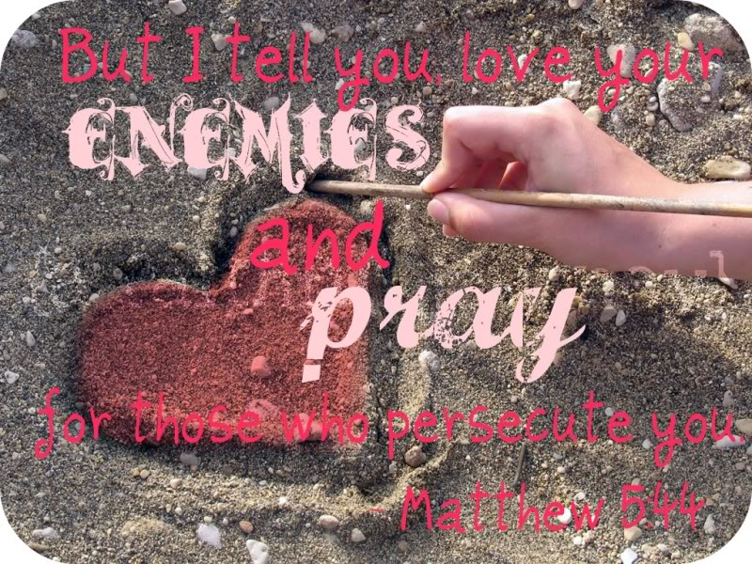
How can you work to break a cycle of violence, revenge, or greed in our world?

Slide 124
This slide is hidden.
Insert the final slide here.

